Slide 1
Car Accidents and Collisions Analise

Slide 2
Introdution
With the help of Historical data, the Problem that we want to solve is to discover knowing some previously information, what the probability of a car accident to be a Injury Collision or Only a Collision.

Slide 3
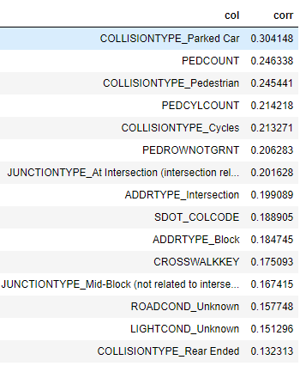
Results
Best Correlation Features

Slide 4
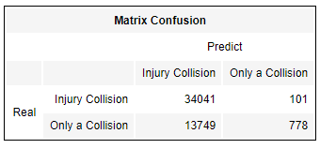
Results

Slide 5
Conclusion
with this model we can obtain a great accuary of injury, we focus in injury that if its a injury collision we have to tell this, if we miss the only collision is not a problem, because of the severity of the subject.

